Slide 1

Course Name: Hardware Security
Faculty Name: Prof Debdeep Mukhopadhyay
Department : Computer Science and Engineering
Topic
Lecture 12: Hardware Implementation of Advanced Encryption

Slide 2

Concepts Covered:
AES Implementation
Mix Columns Implementation
S-Box Implementation Approaches
Composite Field AES
Intel AES Instruction

Slide 3
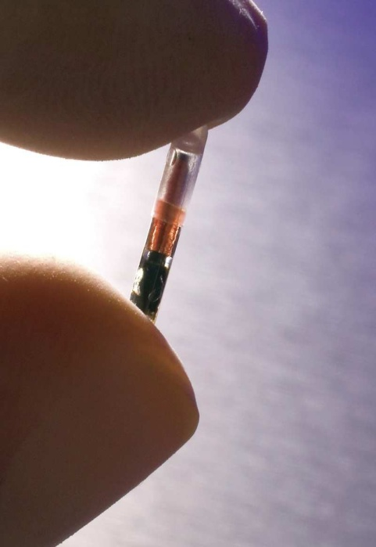
Cryptography Implementations
Important Paradigms
Faster
Higher Clocks
Parallelism
Large Bandwidth
Smaller
Low Power
Smaller Area
Both Applications require security

Slide 4
Design Strategies
2 Strategies to develop efficient hardware
Algorithmic optimizations:Based on mathematical formulations that take advantage of the hardware platform.
Architectural optimizations: Exploit architectural techniques such as pipelining, parallelism,

Slide 5
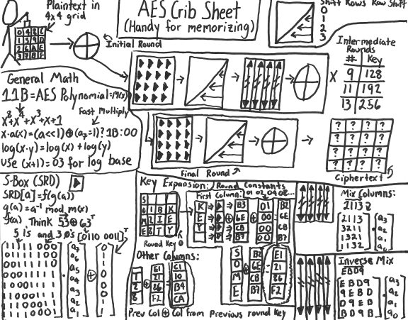

Slide 6
AES Challenges for the Hardware Designer
Reduce area required
Increase throughput
A unified AES engine for both encryption and decryption
Able to handle different key sizes

Slide 7
Mix Column Implementation
a
b
c
d
b
c
d
a
c
d
a
b
d
a
b
c
2x
XOR
2x
XOR
2x
XOR
2x
XOR
key
Multiplying by 2
XOR
XOR
XOR
XOR
F.R.Henríquez et. l., Cryptographic Algorithms on Reconfigurable Hardware, Springer series on Signals and Communication Technology, ISBN 0-387-33883-7
Notes:
7

Slide 8
S-box Implementation in Hardware
Using Tables
requires 256 byte table
Slow due to the Von Neumann Bottle neck
Large area requirements
Suited for software implementations
Using Logical Equations

Slide 9
S-box Using Equations
Naïve Method for Sbox(x)
Compute the inverse of x in GF(2⁸) using the extended Euclidean algorithm
Apply the affine transformation
Requires several
clock cycles
Using Composite Fields
Requires just around 100 gates and can be a combinational circuit.

Slide 10
Composite Fields
AES uses the binary finite field GF(2⁸) with irreducible polynomial
The AES field GF(2⁸) is isomorphic to the field GF((2⁴)²) and even GF(((2²)²)²)
This means that we could find the inverse of
x Є GF(2⁸) by using a smaller field (eg. GF(2⁴))
Thus smaller tables or equations required
Map
Inverse in Composite Field
eg. In GF((2⁴)²)
Reverse
Map
Affine Transform
x
Sbox(x)
Notes:
10

Slide 11
Mapping the Composite Field
Map the field GF(2⁸) to the field GF((2²)²)²)
C.Paar, Efficient VLSI Architectures for Bit Parallel Computation in Galois Fields, PHD Thesis, 1998

Slide 12
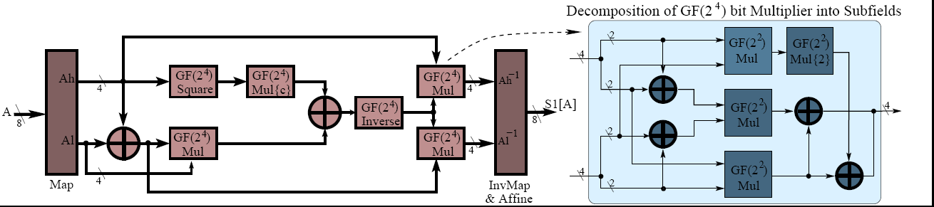
S-box Based on Composite Fields
S-box Approach
Gate Count for composite Sbox#
Performance of S-boxes on FPGA*
XOR | NAND | NOR | Total Gates in terms of NAND (using std cell lib)
80 | 34 | 6 | 180
S-box Approach | No. of Slices | Critical Path | Gate Count
Lookup table based | 64 | 11.9ns | 1128
Composite Field based | 30 | 18.3ns | 312
# D. Canright, A Very Compact S-box for AES, CHES-2005
* Simulation Results using Xilinx ISE

Slide 13
Inverse S-box
Gate Count #
Type | XOR | NAND | NOR | NOT | MUX | Total Gates in terms of NAND gates using std cell library
InvS-box | 81 | 34 | 6 | 0 | 0 | 182
# D. Canright, A Very Compact S-box for AES, CHES-2005

Slide 14
Overhead of Composite Field s-boxes
Composite field s-boxes require mapping and reverse mapping to and from the composite fields in each round
An alternate approach is to convert all other round operations into composite field operations.
This would require just one mapping and one reverse mapping for the entire encryption
Operations Add Round Key and Shift Rows are not altered.
Mix Columns will need to be re-implemented

Slide 15
High Speed AES Encryption-Decryption Architecture
Multiplexing
Pipelining
Key-Gen
Key
Memory
D. Mukhopadhyay et. al, An Efficient End to End Design of Rijndael Cryptosystem in 0.18μ CMOS, VLSID 2005
Input Data
Data
Schedule
Encrypt
Mux
Dispatch
Unit
Ciphertext
Divide
by 4 clock
Decrypt
clock
Enc/ Dec
Instantaneous toggle between
Encrypt and decrypt
Galois Subfield

Slide 16
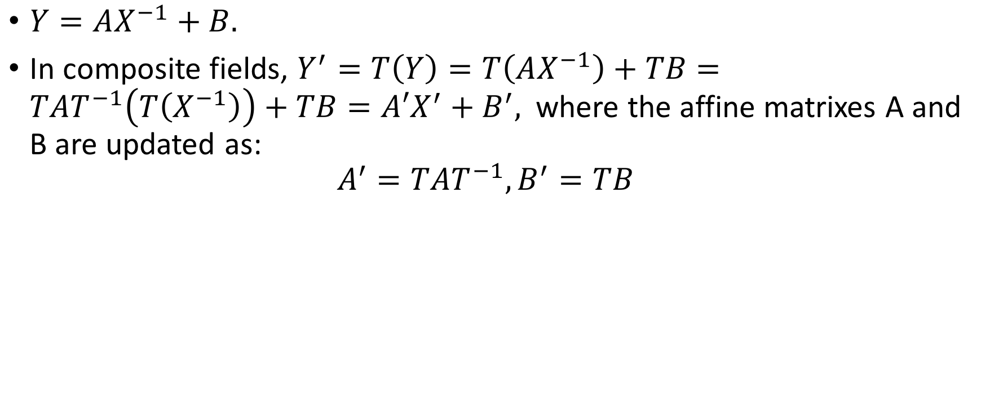
SubBytes in Composite Fields
$Y=AX^{−1}+B.$
In composite fields, $Y^{′}=T\left(Y\right)=T\left(AX^{−1}\right)+TB=TAT^{−1}\left(T\left(X^{−1}\right)\right)+TB=A{′X}^{′}+B^{′},$where the affine matrixes A and B are updated as:
$$A^{′}=TAT^{−1},B^{′}=TB$$

Slide 17
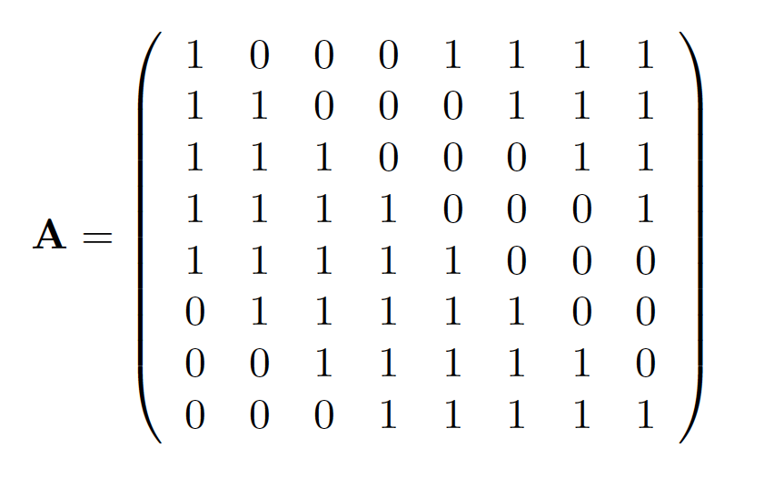
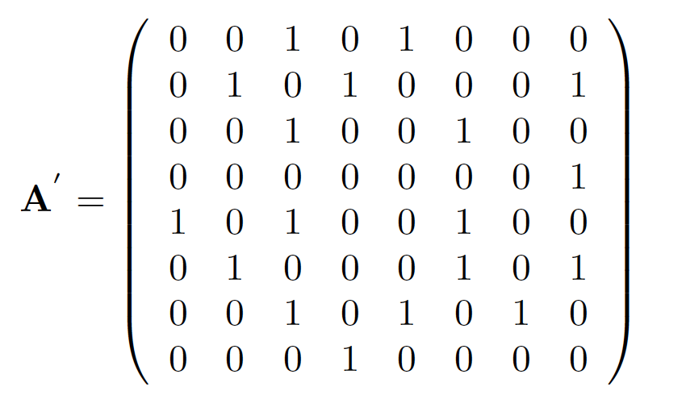
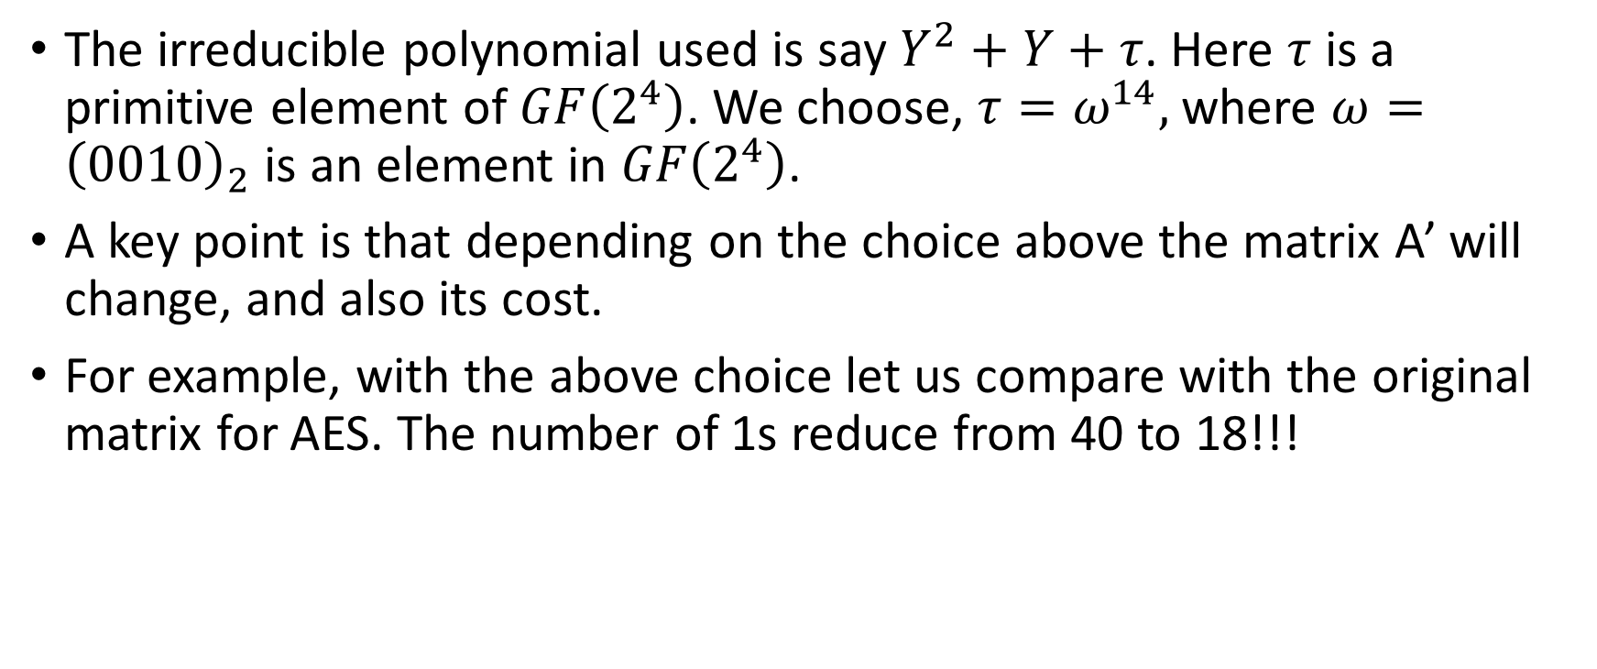
Effect on the matrix values of the Affine Transformation
The irreducible polynomial used is say $Y^{2}+Y+τ$. Here $τ$ is a primitive element of $GF\left(2^{4}\right)$. We choose, $τ=ω^{14},$where $ω={\left(0010\right)}_{2}$ is an element in $GF\left(2^{4}\right)$.
A key point is that depending on the choice above the matrix A’ will change, and also its cost.
For example, with the above choice let us compare with the original matrix for AES. The number of 1s reduce from 40 to 18!!!

Slide 18
Mix Columns in Composite Fields
In Composite Fields
Consider the composite field GF((2⁴)²) with
irreducible polynomial
Every element in this field is represented
as a₁x + a₀ , where a₁ and a₀ Є GF(2⁴)

Slide 19
The Decryption Flow
Add Round Key
Keymem
Add Round Key
Add Round Key
Keymem
Buffer
Buffer
Buffer
InvShift Row
Byte Sub
Inv ByteSub
Shift Row
Inv Byte Sub
Inv Shift Row
Mix Column
Add RoundKey
Keymem
Inv Mix Column
Buffer
Buffer
Buffer
Keymem
Inv Mix
Column
Add Round Key
Keymem
Inv Mix Column
Add Round Key
Buffer
Buffer
Buffer
Byte Sub
Inv Shift Row
Inv Byte Sub
Shift Row
Inv Byte Sub
Inv Shift Row
Keymem
Add Round Key
Keymem
Add Round Key
Keymen
Add Round Key
Buffer
Buffer
Buffer

Slide 20
Compact Encryption-Decryption Architecture
Merge the operations in the encryption and decryption into a single unit.
Key-Gen
Key
Memory
Input Data
Data
Schedule
Encrypt/
Decrypt
Dispatch
Unit
Enc/ Dec

Slide 21
Merged Round Operations
Addroundkey is the same in both encryption and decryption
ShiftRows and InverseShiftRows only differ in the direction of shifting

Slide 22
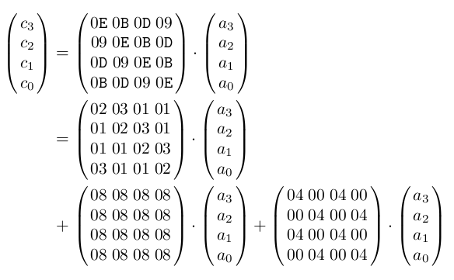
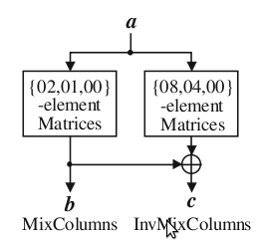
Merged Mix Columns
 | Separate Mix (Inv) Columns | Merged Mix Columns
No. of XOR gates | 152 + 440 = 592 | 195
Delay (gates) | 5 | 7
A. Satoh et. al., A compact Rijndael Hardware Architecture with S-box Optimization, ASIACRYPT 2001

Slide 23
Merged S-boxes
Map
Reverse
Map,
Affine
x
or
Sbox[x]
Inverse in Composite Field
eg. In GF((2⁴)²)
Sbox[x]
or x
Reverse
Map
Map,
Revse Affine
Type | Total Gates in terms of NAND gates using std cell library
Sbox + InvSbox | 362
Merged | 234
# D. Canright, A Very Compact S-box for AES, CHES-2005

Slide 24
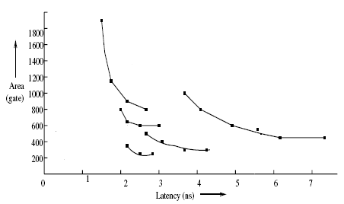
Different Schools of Designs
Verbauwhede
Wolkerstorfer
Hodjat
Alam
Satoh
J.Wolkerstorfer, E.Oswald and M. Lamberger: An ASIC Implementation of the AES S-boxes: in Proc. RSA Conference (CT-RSA) 2002, LNCS Vol. 2271, pp.67-78, San Jose, CA, Feb. 2002.
M. Alam et. al., An Area Optimized Reconfigurable Encryptor for AES-Rijndael, DATE 2007
A. Satoh et. al., A compact Rijndael Hardware Architecture with S-box Optimization, ASIACRYPT 2001
I. Verbauwhede, P. Schaumont, H. KuoDesign and Performance Testing of a 2.29-GB/s Rijndael Processor, IEEE Journal of Solid State Circuit, 2003.
A . Hodjat et. al. Area Throughput Tradeoffs for Fully Pipelined 30 to 70 Gbits/s AES Processors, IEEE Trans on Computers 2006

Slide 25
State of the Art
Intel has introduced dedicated hardware for AES on its microprocessors
These are accessed by dedicated AES instructions
The AES design consists of:
Standard techniques used such as composite fields, single map – reverse map, etc.
Speed of 53Gbps obtained by fully custom design flow on 45nm technology.
S. Mathew, 53Gbps Native GF(2⁴)² Composite Field AES-Encrypt/Decrypt Accelerator for Content Protection in 45nm
High Performance Microprocessors,VTS 2010

Slide 26
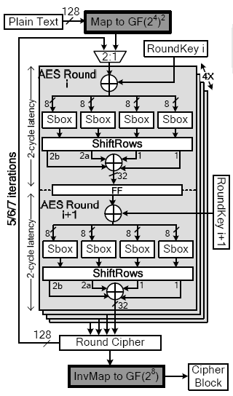
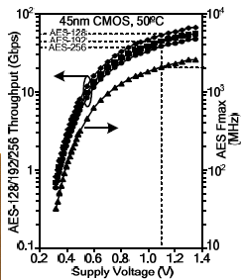
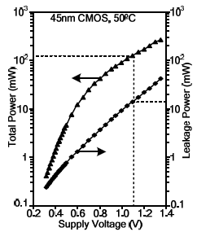
Intel’s AES Hardware
S. Mathew, 53Gbps Native GF(2⁴⁾² Composite Field AES-Encrypt/Decrypt Accelerator for Content Protection in 45nm
High Performance Microprocessors,VTS 2010

Slide 27


Slide 28
Conclusion:
Design of AES
Design of Sub-block of AES:
Mix Columns
S-Box
Design of S-Box is challenging
Techniques using Isomorphism seem promising to realize compact S-Boxes.

Slide 29


